Slide 1
Topic: Bivariate Data
EQ: How do I read Scatterplots?

Slide 2
24
7
30
Date:
Bivariate Data
EQ: How do I read Scatterplots?
A scatterplot is used to determine if there is a relationship between two numerical variables.
Once you have created a scatterplot you need to be able to use it to see if there is a relationship between the two variables plotted.
The next slide (slide 4) shows you how you can go about reading and interpreting basic things from the scatterplot. Use this example to answer the questions on the worksheet that is attached to this PowerPoint.

Slide 3
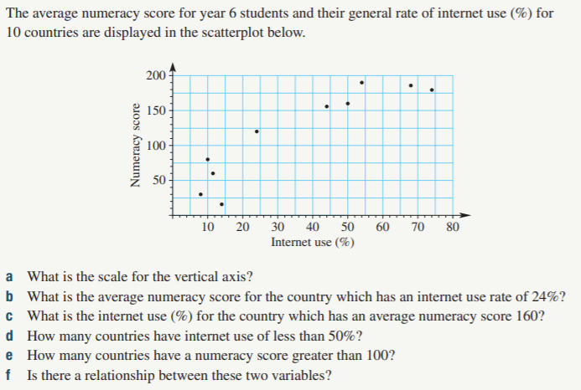
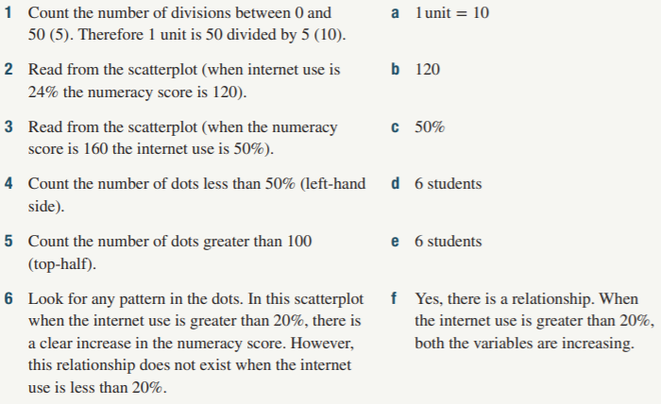
24
7
30
Date:
Bivariate Data
EQ: How do I read Scatterplots?
Example
Solution

